Slide 1

Design and Implementation of Employee Information and Payroll Management System
Presented by :
MD. MAFUJUL HASAN (CSE1903018137)
NAZMUL HOSSAIN (CSE1903018114)
Supervised by
Bulbul Ahamed
Associate Professor and Head,
Department of Computer Science and Engineering
Sonargaon University (SU)

Slide 2

Introduction
Welcome to our presentation on employee information and payroll management systems. In today's fast-paced business environment, it is more important than ever for companies to have an efficient and effective way of managing their employees' information and payroll.
Traditional methods of managing this data can be time-consuming, error-prone, and costly. That's why many businesses are turning to automated systems that can streamline the process and provide accurate data in real-time. In this presentation, we will explore the benefits of such systems, as well as the challenges and best practices for implementing them.

Slide 3

Say Good Bye To Manual Payroll
An Online employee payroll Management System, is a system where employee can apply for leaves and admin/HR Manager can approve/reject leaves request.
Admin can Manage attendance of all employees and manage Payroll of all employee, managing shifts, allotting particular branch of the company to add new or existing employee

Slide 4

Challenges in Employee Information and Payroll Management System
Managing employee information and payroll manually can be a daunting task for businesses. Not only does it require significant time and effort, but it also leaves room for errors and inaccuracies. In fact, according to a recent study, manual payroll processing has an error rate of about 1-8%, which can lead to costly mistakes and legal issues.
Another challenge of employee payroll management is the lack of visibility and accessibility. When information is stored in paper files or spreadsheets, it can be difficult to track and access when needed. This can lead to delays in processing and payments, as well as frustration for employees who may have questions or concerns about their pay.

Slide 5

Benefits of an Employee Information and Payroll Management System
Implementing an employee information and payroll management system can bring numerous benefits to your organization. First and foremost, it can significantly reduce the time and effort required for manual data entry and processing. In fact, studies show that organizations that use automated payroll systems save up to 60% of their time compared to those that don't.
Moreover, an employee information and payroll management system can help improve accuracy and compliance. By automating the process, you can minimize errors and ensure that all necessary taxes and deductions are properly calculated and reported. This not only helps avoid penalties and fines but also builds trust among employees who rely on accurate and timely paychecks.

Slide 6

Features of a Good Employee Information and Payroll Management System
A good employee information and payroll management system should have a user-friendly interface that is easy to navigate. This will save time and reduce errors when entering and retrieving data. Additionally, the system should allow for customization of fields and reports to meet the specific needs of the business.
Another important feature is integration with other software systems such as accounting and HR management. This will streamline processes and eliminate the need for manual data entry and reconciliation. The system should also have robust security measures in place to protect sensitive employee data from breaches and unauthorized access.

Slide 7

Security and Data Privacy
Employee information and payroll management systems deal with sensitive data that can have serious consequences if it falls into the wrong hands. Data breaches can result in identity theft, financial loss, and damage to a business's reputation. That's why security and data privacy are crucial considerations when choosing a system.
Businesses need to ensure that their employee information and payroll management system has robust security measures in place, such as encryption, firewalls, and access controls. They should also have policies and procedures in place for handling sensitive data, such as regular backups and secure disposal of old records. By taking these steps, businesses can protect themselves and their employees from potential data breaches.

Slide 8

Go Online (Unique Feature)
Online Chat : Our System manages the messages to be delivered to the employees. Employees, at any level of designation, can chat or send a message to any other employee of company If both the employees are online at same the time, they can give immediate response to each other The advantage about this feature is that, any employee can solve the query by asking the particular employee

Slide 9
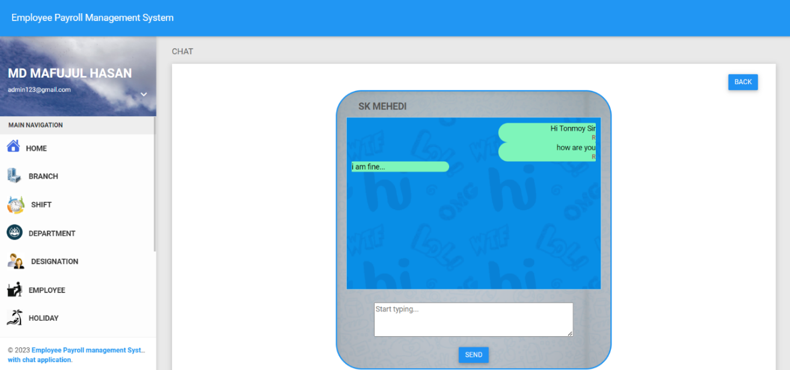
CHAT BOX

Slide 10
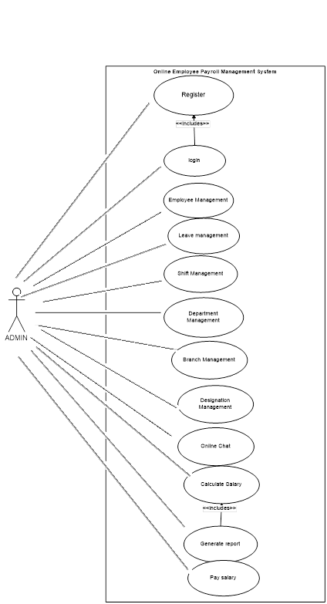
Use-Case Diagram of Employee Payroll Management System
A use case diagram is a graphical representation of the interactions between actors and a system. It shows the different ways that a user or external system can interact with the software, as well as the responses of the system to those interactions.
Use case diagrams are an important tool in software development because they help developers and stakeholders understand the requirements of the system.

Slide 11
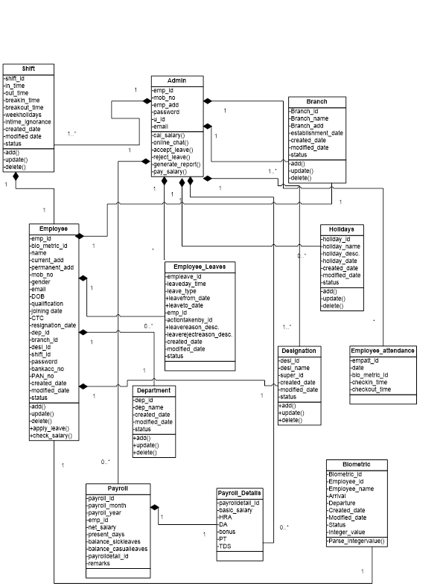
Class Diagram of Employee Payroll Management System
A class diagram is a type of UML diagram that represents the structure of a system by showing the classes, their attributes, methods, and relationships between objects. It provides a visual representation of the code and helps developers to understand the overall architecture of the system.

Slide 12

We provide Easy to read Reports
Our detailed Report includes -
Payroll Summary
Consolidated Report
Arrival Departure Time
Holiday type
Absence/presence
Late out
Shifts

Slide 13

Data Dictionary
Department
Shift
Designation
Branch
Holidays
Employee
Employee Attendance
Employee Leaves
Payroll
Payroll Details
Chat

Slide 14

Future of Employee Information and Payroll Management
The future of employee information and payroll management is looking increasingly automated and data-driven. With advances in artificial intelligence, machine learning, and big data analytics, businesses will have access to more accurate and real-time information about their employees than ever before.
One trend that is likely to emerge in the coming years is the use of predictive analytics to forecast employee turnover rates and identify potential performance issues before they become major problems. This will allow businesses to take proactive steps to retain top talent and improve overall productivity. Another trend is the use of blockchain technology to securely store and manage employee data, ensuring that it remains private and tamper-proof.

Slide 15

Conclusion
In conclusion, it is clear that implementing an automated employee information and payroll management system can bring numerous benefits to businesses. Not only does it save time and money, but it also helps improve accuracy and compliance. By eliminating manual processes, businesses can focus on more strategic tasks and make better decisions based on real-time data.
However, it is important for businesses to carefully consider their options and choose a system that meets their specific needs. They should look for features such as customizable reporting, integration with other software, and robust security measures. Additionally, they should ensure proper training and support for employees during the implementation process to maximize the system's potential.

Slide 16

Q&A
Thank you for your attention. Now, we would like to open the floor for any questions or concerns that you may have regarding employee information and payroll management systems.

Slide 17

Thank You
Thank you for taking the time to learn about the benefits of implementing an employee information and payroll management system. We hope that this presentation has shed light on the challenges faced by businesses when managing employee data manually, and the benefits of automating these processes.

